Slide 1

A Data-Driven Analysis of Adult Health Parameters and the Impact of Smoking
PRASIN K M
Luminar Technolab – Data Science Intern

Slide 2
Why this study matters
Lifestyle diseases are rising due to poor habits such as smoking and lack of physical activity.
Key health parameters (BMI, Blood Pressure, Cholesterol, etc.) reflect overall wellness.
This study analyzes real data to evaluate adult health and assess how smoking affects vital metrics.

Slide 3
Objective:
To compare adult health parameters with standard medical ranges and examine the influence of smoking.

Slide 4
Dataset Description:
Total Records: 52855 adults
Columns: Age, Gender, Height, Weight, BMI, Temperature, Heart Rate, Blood Pressure, Cholesterol, Diabetes, Smoking
Age group: 18 - 34
Smoking: 1 → Smoker, 2 → Non-Smoker
Purpose:
To evaluate physical health performance based on these metrics and compare smoking vs non-smoking patterns.

Slide 5
Data Preparation Steps:
Cleaned missing or invalid values.
Segment participants according to their needs.
Visualized trends using Python libraries (NumPy, Pandas, Matplotlib, Seaborn).
Analytical Focus:
Compare each health metric to standard adult ranges.
Evaluate smoking influence across multiple variables

Slide 6
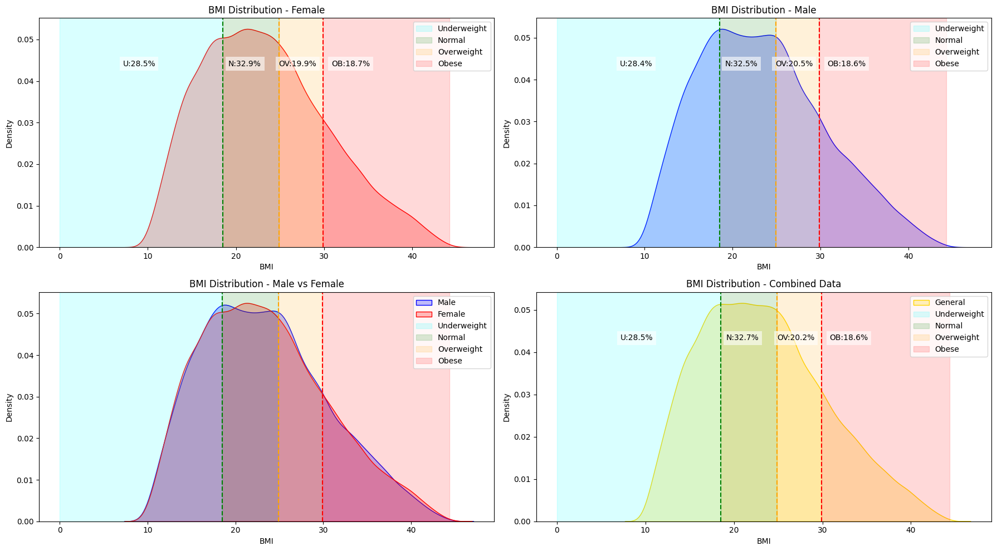
Comparison with Standard Adult Ranges:

Slide 7
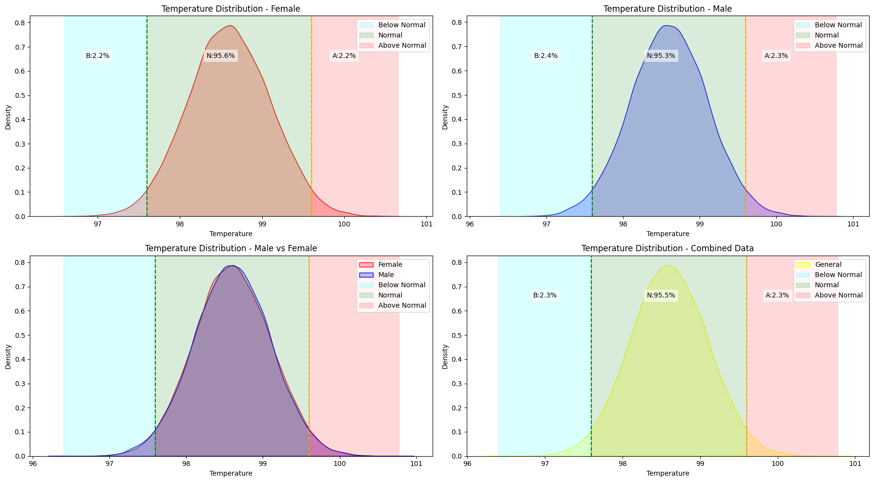

Slide 8
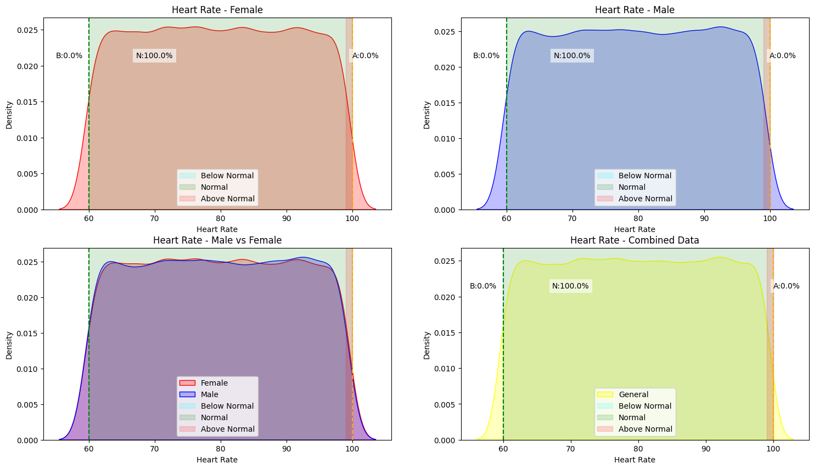

Slide 9
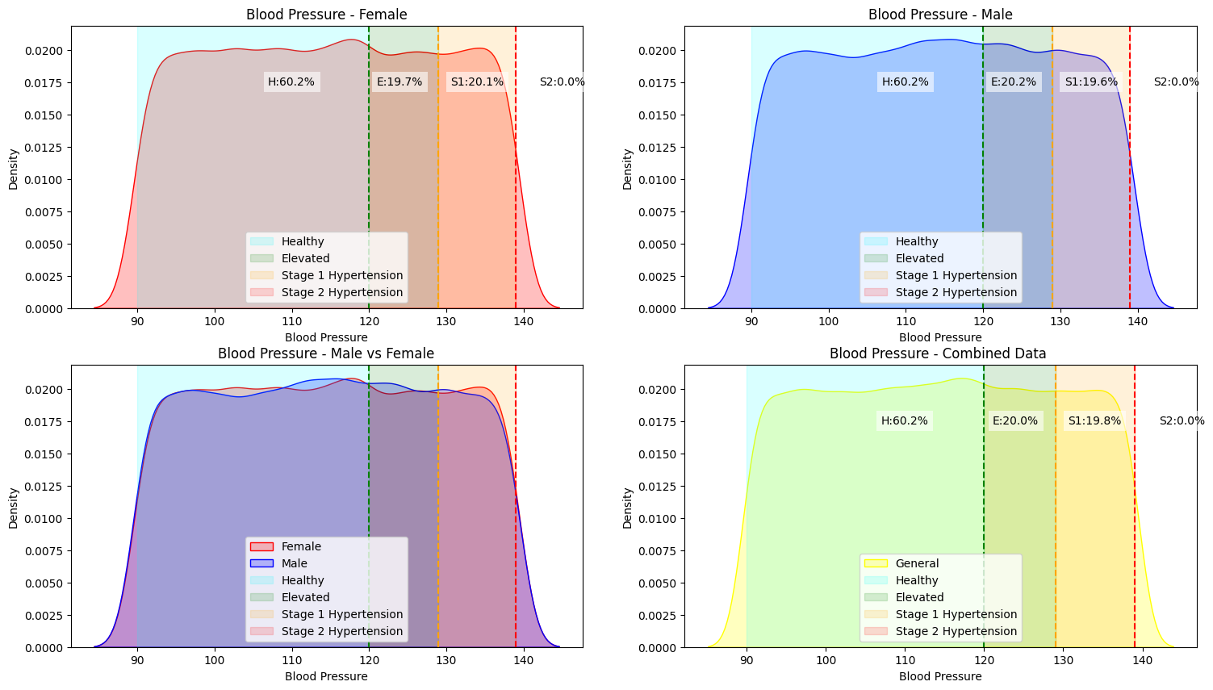

Slide 10
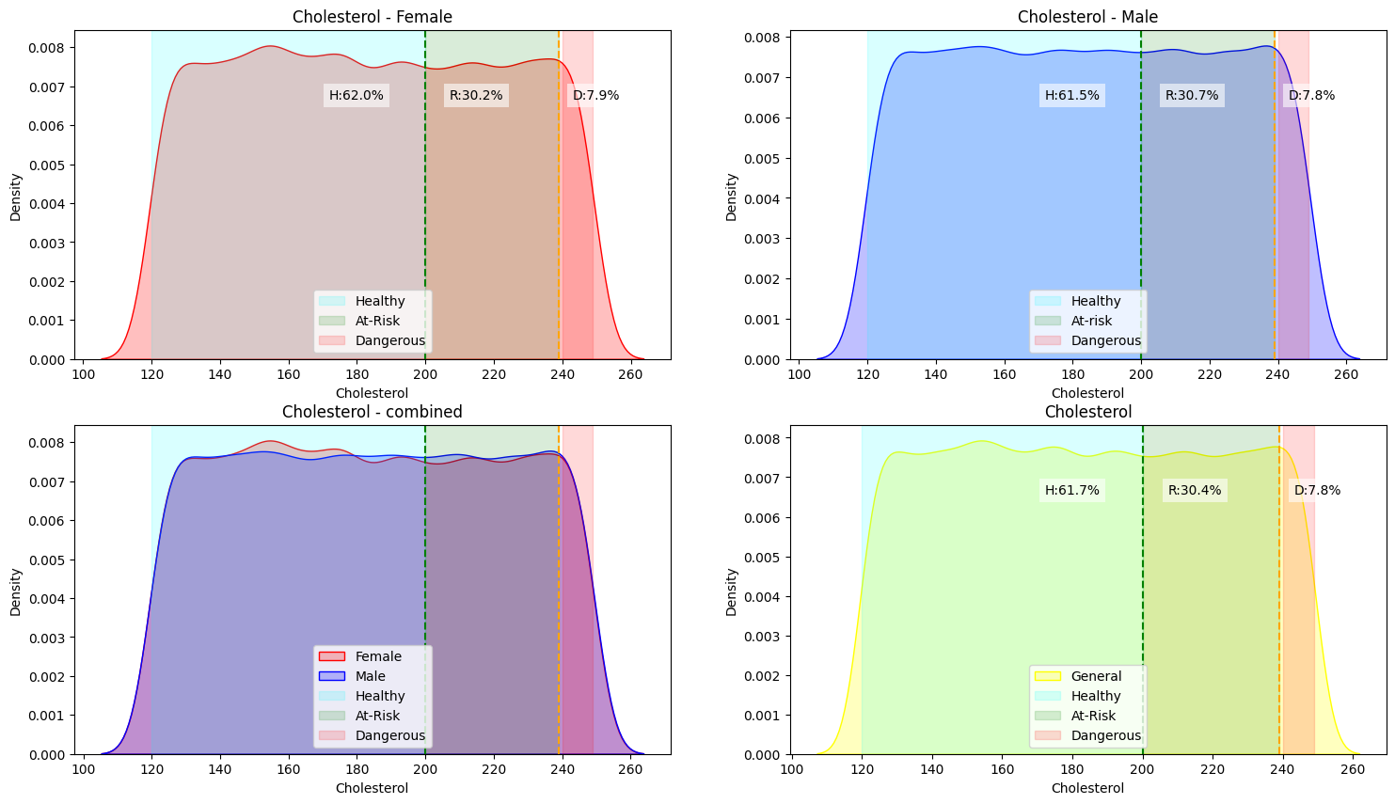

Slide 11
Parameter | Standard Adult Range | Observation (from data) | Remarks / Insights
BMI (Body Mass Index) | 18.5 – 24.9 (Normal) | Underweight: 28.5% Normal: 32.7% Overweight: 20.2% Obese: 18.6% | Nearly one-third normal. Slight right-skew shows overweight tendency in both genders.
Temperature (°F) | 97.6 – 99.6 | Normal: 95.5% Below: 2.3% - Above: 2.3% | Stable and symmetric distribution; indicates overall good body temperature regulation.
Heart Rate (bpm) | 60 – 100 | Normal: 100% Below/Above: 0% | All participants within healthy heart rate range — strong cardiovascular indicator.
Blood Pressure (mmHg) | <120 (Healthy) 120–129 (Elevated) 130–139 (Stage 1 Hypertension) | Healthy: 60.2% Elevated: 20.0% Stage 1: 19.8% Stage 2: 0% | Most adults are healthy, but nearly 40% show early signs of hypertension risk.
Cholesterol (mg/dL) | <200 (Healthy) 200–239 (At-Risk) ≥240 (Dangerous) | Healthy: 61.7% At-Risk: 30.4% Dangerous: 7.8% | Cholesterol levels trending high — possible link to lifestyle factors like smoking or diet.

Slide 12
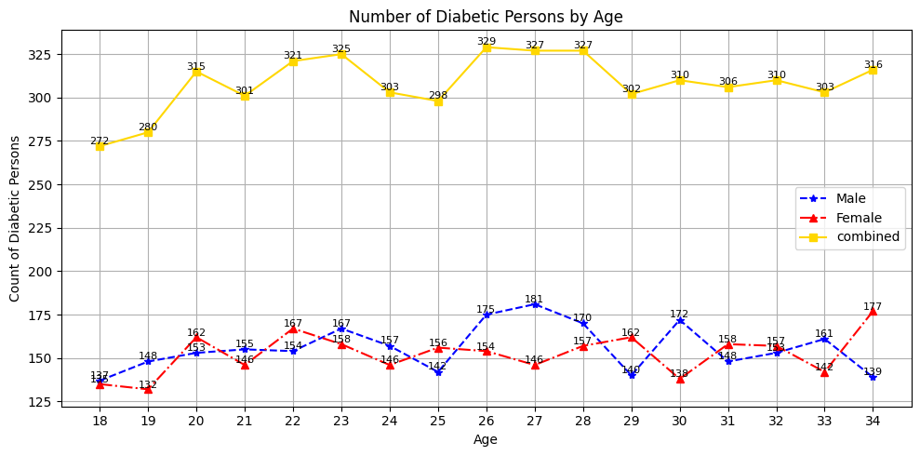
The presence of diabetes in younger adults (18–34) highlights early lifestyle-related health issues, likely influenced by BMI, cholesterol, and smoking behavior. Preventive health measures and screening should begin early in adulthood.

Slide 13
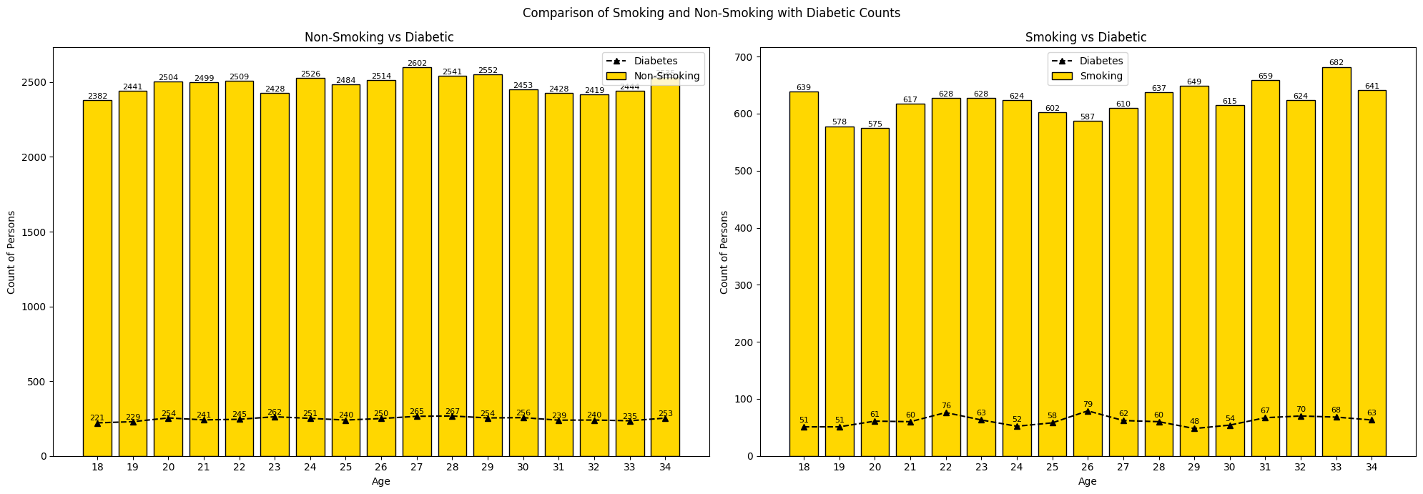
Smoking vs Non-Smoking Analysis
Observation Area | Insight
Observation | Smoking individuals show a slightly higher diabetes incidence rate compared to non-smokers. - The difference is not drastic but consistent across most age groups, indicating smoking as a contributing risk factor for diabetes onset.
Health Implication | While diabetes is present in both groups, smoking clearly correlates with a higher proportional risk. - This supports medical research that smoking can impair insulin sensitivity and increase Type-2 diabetes risk.

Slide 14
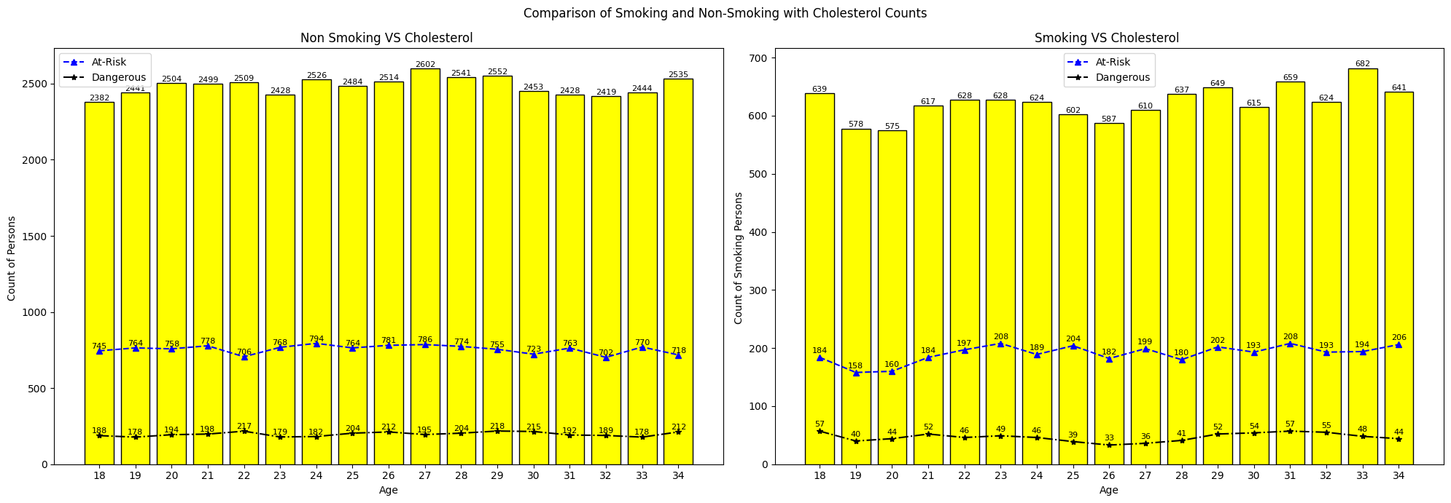
Observation Area | Insight
Comparison | For non-smokers, only about 10% have dangerous cholesterol. For smokers, this rises to 6–9%, even though their group size is smaller — showing a stronger impact of smoking on cholesterol imbalance.
Health Implication | Smoking significantly contributes to higher cholesterol risk (both at-risk and dangerous categories). - Non-smokers maintain better lipid health overall, but even they show a notable percentage of elevated cholesterol, indicating diet or BMI may also play a role.

Slide 15
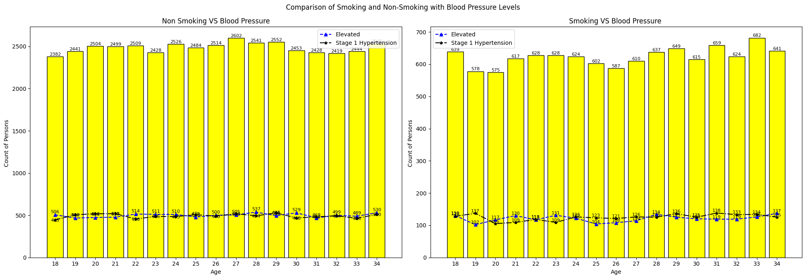
Observation Area | Insight
Comparison | Non-smokers: roughly 35–40% have some BP elevation. - Smokers: roughly 45–50% show elevated or hypertensive readings — clearly higher proportionally. - Indicates a consistent link between smoking and higher blood pressure.
Health Implications | Smoking significantly contributes to higher risk of hypertension, even in young adults (18–34). - The difference between smokers and non-smokers is visible despite the smaller smoker population, suggesting a direct physiological impact of nicotine on BP levels.

Slide 16
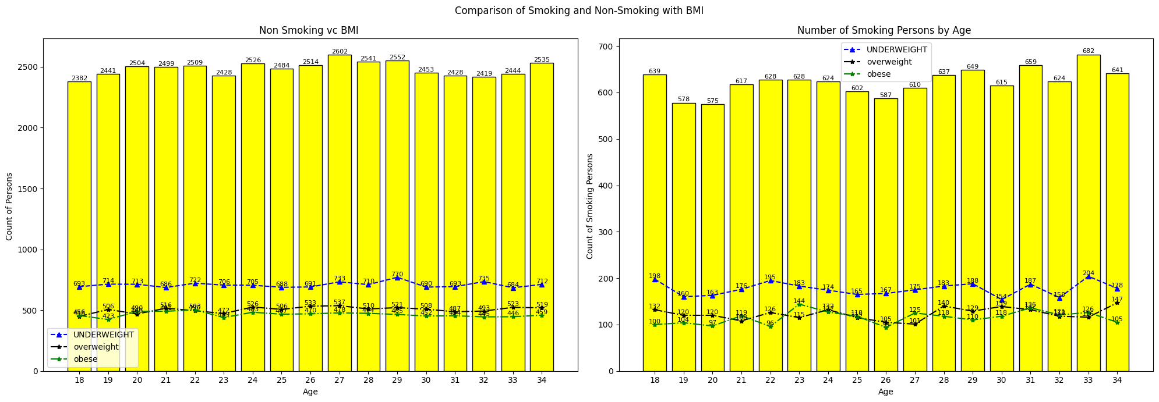
Observation Area | Insight
Observation | - Non-smokers show more balanced weight distribution, with steady proportions across categories. - Smokers display fewer overweight/obese individuals but more underweight cases, consistent with smoking-related metabolic effects.
Health Implication | - Smoking is correlated with lower BMI values — possibly due to nicotine’s appetite-suppressing effects. - However, lower BMI doesn’t imply better health; smoking still elevates risks for cardiovascular and metabolic diseases.

Slide 17
Key Findings – Influence of Smoking on Health Indicators
Health Parameter | Non-Smoking Group Observation | Smoking Group Observation | Key Finding / Insight
BMI (Body Mass Index) | Balanced distribution: ~30% underweight, 20% overweight, 18% obese. | More underweight individuals (~30%); fewer overweight/obese. | Smoking correlates with lower BMI, likely due to appetite suppression from nicotine.
Blood Pressure | 35–40% show elevated or Stage 1 hypertension. | 45–50% show elevated BP or early hypertension. | Smokers exhibit a higher prevalence of hypertension, indicating smoking’s effect on cardiovascular strain.
Cholesterol | ~30–35% at-risk; ~10% dangerous. | ~35–40% at-risk; ~6–9% dangerous. | Smokers have higher cholesterol on average — risk for heart disease increases.
Diabetes | Diabetic count steady (~220–265 per age group). | Slightly higher diabetic ratio (~48–79 per ~600 smokers). | Smoking group shows a greater proportion of diabetics, suggesting impaired glucose metabolism.

Slide 18
Conclusion and Recommendations
Conclusion:
The analysis of adult health data reveals that smoking has a significant negative influence on several vital health parameters.
Although smokers tend to have lower BMI, this does not indicate better health — instead, they show higher risks of hypertension, elevated cholesterol, and diabetes.
Non-smokers, by contrast, maintain a more balanced health profile across BMI, blood pressure, and cholesterol categories.
Across all age groups (18–34), the data consistently demonstrates that smoking correlates with metabolic and cardiovascular imbalances, suggesting long-term health risks even in young adults.
The findings validate that smoking’s impact is systemic — affecting the heart, metabolism, and endocrine function — rather than limited to respiratory health alone.

Slide 19
Recommendations:
Smoking Cessation Programs:
Encourage young adults to quit smoking through counseling and awareness programs focused on long-term cardiovascular and metabolic effects.
2. Regular Health Screenings:
Implement periodic monitoring of blood pressure, cholesterol, and glucose levels for early detection and management of health risks in both smokers and non-smokers.
3. Lifestyle Modifications:
Promote balanced diets, physical activity, and stress reduction to maintain healthy BMI and reduce cholesterol accumulation.
4. Data-Driven Health Awareness:
Use analytical studies like this to highlight quantitative evidence of smoking’s impact, making prevention campaigns more persuasive

Slide 20
Thank you
PRASIN K M

